Slide 1
Sponsors
Cynthia Wang & Zachary Vernon
Current Developers
Team 1: Melissa Hernandez, Channing Jou, Thien Ho, Stephanie Tan
Team 2: Juan Alcobas, Hak Beak, Ryan Goshorn, Daniel Rodas, Raul Sanchez Martinez
Advisor
John Hurley
Notes:
Jorge -

Slide 2
Agenda:
What is The arqive?
Project Tools & Technology
Team Goals & Accomplishments
Team Challenges
Demo

Slide 3
What is The Arqive?
The Arqive is a digital online storytelling map that facilitates the sharing of LGBTQ+ stories. It provides a platform for queer individuals to create and collect stories that are geolocated and digitally preserve
Users from all around the world have a safe platform where they can share personal, historical, and community stories, as well as have access to information about safe spaces.
“By sharing stories, we can give each other hope.”
- Cynthia Wang

Slide 4
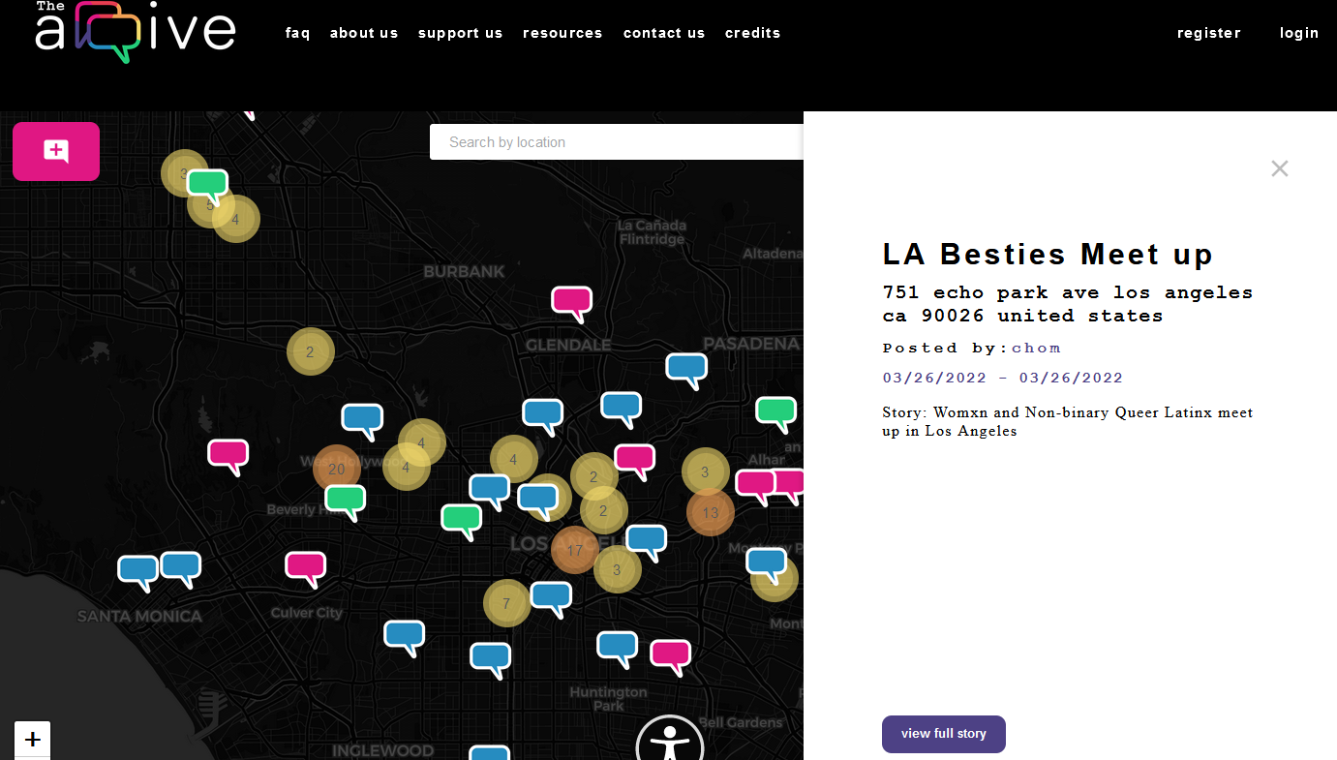
Overview of The Arqive:
Users
Login
Add/Edit/Delete/Tag stories
Block/Unblock Users
Flag Posts
Manage Profile
Anonymity Feature
Admin
Login
Add/Edit/Delete/Tag Story
Delete Users
Review/Remove Flagged Posts
Review/Remove Flagged Comments

Slide 5
Project Tools & Technology

Slide 6
Django Rest
Django REST framework (DRF) is a powerful toolkit for building Web APIs in Django, which is a popular high-level Python web framework. It provides a set of tools and libraries that help simplify the creation of RESTful APIs which are a standard way for different systems to talk to each other over the internet..
Notes:
Thien Ho

Slide 7
Node js
Node.js is a JavaScript runtime environment that allows you to run JavaScript on the server-side. Node.js is commonly used for server-side scripting and building backend services for web applications. With Node.js, developers can use JavaScript to write server-side code, handle HTTP requests, interact with databases, and perform other server-side tasks.
Notes:
Thien Ho

Slide 8
React.js and React Native
React is a JavaScript library used for building user interfaces, especially for single-page applications. React allows developers to create dynamic, interactive UIs by efficiently updating based on changes in data.
React Native is a framework developed by Meta that allows you to build mobile applications using JavaScript and React. It's an extension of React.js but tailored specifically for mobile app development.
Notes:
Thien Ho

Slide 9
Honorable Mentions
Ubuntu
Docker
Digital Ocean
PostgreSQL
AR.js
Web APIs
OpenStreetMap
Notes:
Thien Ho

Slide 10
Team Goals & Accomplishments

Slide 11
Team 1’s Goals
Throughout the semester team 1 was assigned two main functions for the website.
Our original goal was to implement multimedia upload which included: images, gifs, videos, and audio.
Our second function, which was assigned later in the semester, was implementing a nsfw (not safe for work) tag for any posts made on the website. This took priority due to the fact that The Arqive sponsors were trying to launch their mobile app and needed to meet specific criteria to be approved for the app store.

Slide 12
Team 1’s Accomplishments
These are the things that team 1 was able to accomplish throughout the year!
By using code provided by last years seniors we were able to build on the multimedia back end. Multimedia upload is now in the beginning stages of front end development.
In addition, both front end and back end for our nsfw function are ready to be deployed to the website. This means users will now be able to tag their posts as nsfw along with having the option to regulate what type of content they are exposed to. There are three settings that are available to all users!

Slide 13
Team 2’s Goals
Similarly team 2 was also assigned two main functions to implement.
Provide our users with a secure authentication process. Ensures their information is safe and protected from unauthorized access.
Add a block function that allows users to block another user and prevent them from seeing their posts and comments. Enhance user control over their online experience.

Slide 14
Team 2’s Accomplishments
These are the things team 2 was able to accomplish throughout the year!
The websites authentication process was successfully secured. We built upon the existing framework and focused on areas requiring improvement, ensuring the protection of users' information and data.
The block function was finished and implemented. With this, users have the ability to block any users and their posts. This makes sure users feel safe while interacting with others on the platform.
Additionally, our group took over in the development of the mobile app!

Slide 15
Project Challenges

Slide 16
Challenges Faced by Group
Originally both teams struggled with getting used to the frameworks and languages as we were unfamiliar with some of them. This included understanding code that seniors from last semester passed down to us.
There were also issues setting up our environment for a while since we were doing something different from previous semesters.
Team leads struggled with assigning work and determining the most efficient individuals for specific scenarios, as certain team members excelled in certain situations but not in others.

Slide 17
Demonstration

Slide 18
Authentication
Django-Rest-Knox: A third-party authentication library that was developed for use with Django-Rest. Focuses on validating requests through the use of tokens.
A more secure version of Django-Rest’s built-in TokenAuthentication
A token is generated when the user begins their session (logs-in)
Unlike the default TokenAuthentication, Knox tokens are stored in database under a secure hash form; attackers are not able to easily obtain and use the tokens

Slide 19
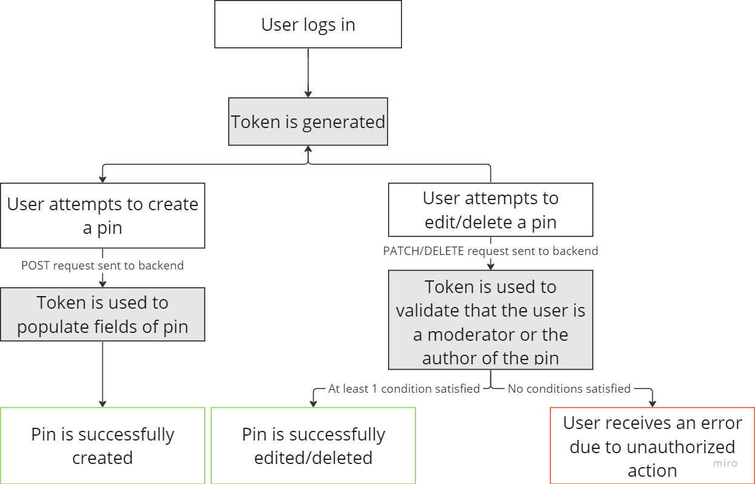
Authentication

Slide 20
Authentication
Postman: Platform for building and using API’s.
Used for testing and modifying requests to the
backend.
Endpoints are defined in the url file, or obtained from a third-party app such as Chrome’s DevTools or a Docker container.
The requests to an endpoint can be modified by manually changing the headers and body of the requests, and this helps when detecting and patching vulnerabilities using views on Django.

Slide 21
Demo - Multimedia Backend

Slide 22
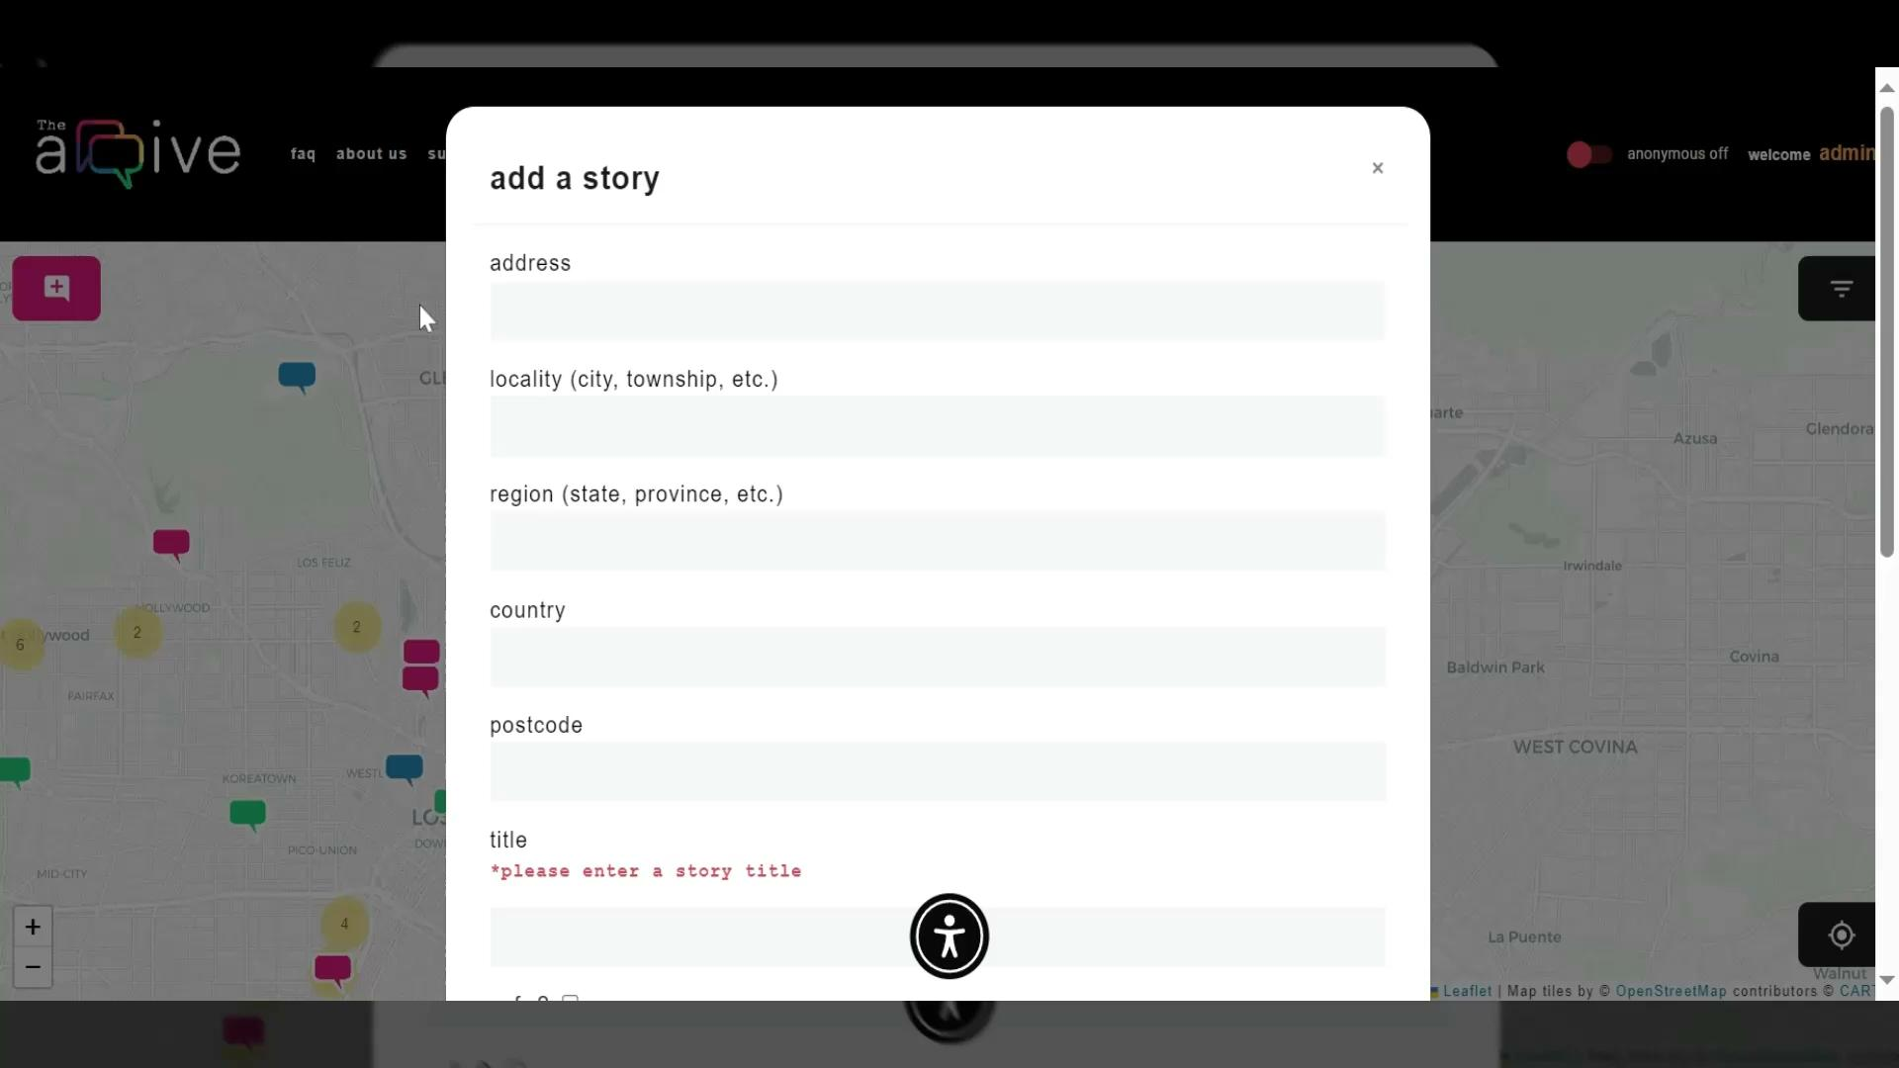
Demo - NSFW

Slide 23
Demo - Blocking

Slide 24
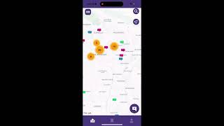
Demo - iOS App

Slide 25
Thank you!
Any Questions?

